Slide 1
The Task Titans
Christina, Matt, Katelyn, Emily, & Brooke

Slide 2
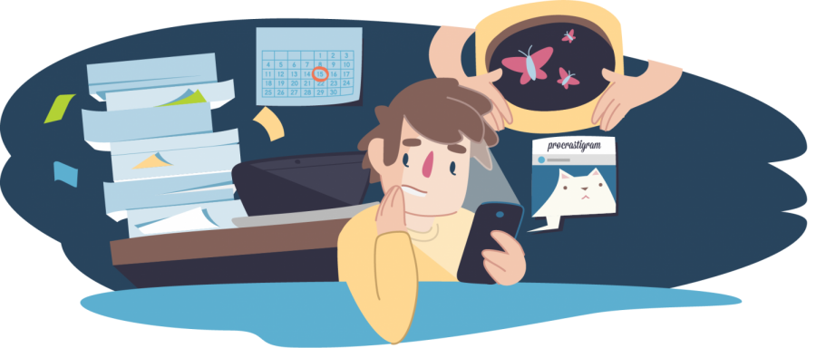
Problem
How can we manage tasks efficiently?
stress & overwhelming workload
poor time management
scattered to-do lists
scattered calendars
lack of prioritization
lack of organization
lack of accountability
procrastination
insufficient resources!

Slide 3
Proposed Solution
TaskBuddy
Provide users with an efficient and user-friendly platform for managing their tasks and responsibilities
Reliable
Ensures that users can access and manage their tasks regardless of network connectivity and can navigate through their tasks without experiencing delays
Organized
Users will have the ability to have different task lists, sub-tasks, and overlapping tasks
Intuitive Navigation
Establish design patterns that users can effortlessly navigate through
Adaptable
Adapts to different screen sizes

Slide 4
Relation to Project
The goal of this project is to create an application that can ease the stress of trying to effectively manage time and responsibilities
TaskBuddy’s reliable, organized, intuitive, and adaptable nature allows users to easily organize their tasks and deadlines without any added stress
TaskBuddy will increase productivity by providing a centralized area for all the user’s tasks

Slide 5
Use Case
Use Case: Add a task to to-do list
Preconditions
User should be logged into their account with access to the task database.
Main Flow
User will click the button requesting a new task to be created[S1]. Program allows for the user to input necessary information about the task such as name and deadline [S2]. Program adds the task to the database and the UI is updated to show the added task [S3].
Subflows
[S1] User clicks the button to add a new task
[S2] Program will prompt the user to enter the name of the task, and the desired deadline (if necessary) for the task
[S3] Once the user confirms the task, the program will add the task to to the database and will be reflected in the UI
Alternative Flows
[E1] User cancels adding the task before confirming it

